Slide 1
NWP
Power measurement
Database
Prediction Model
Evaluation
NWP wind speed and direction forecast patterns
00
12
00
12
00
12
00
12
Wind Power Measurements

Slide 2
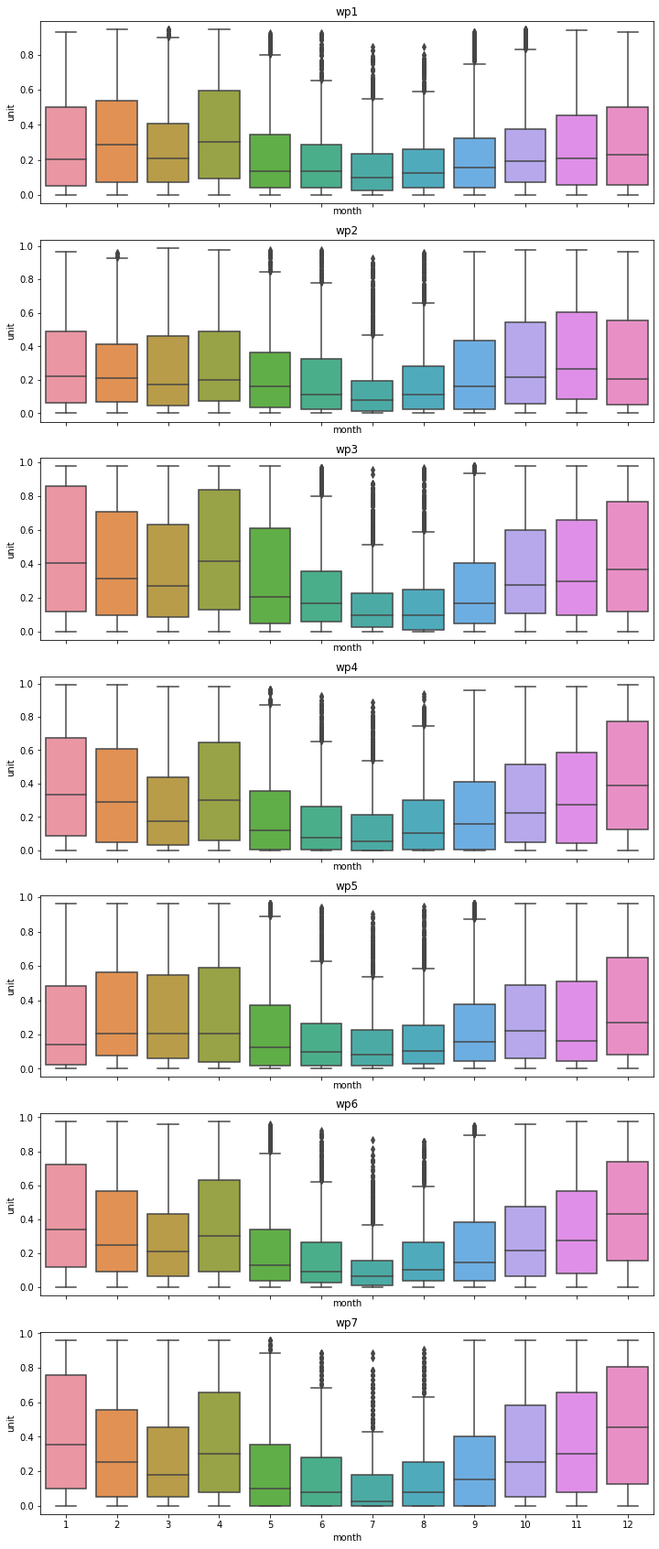
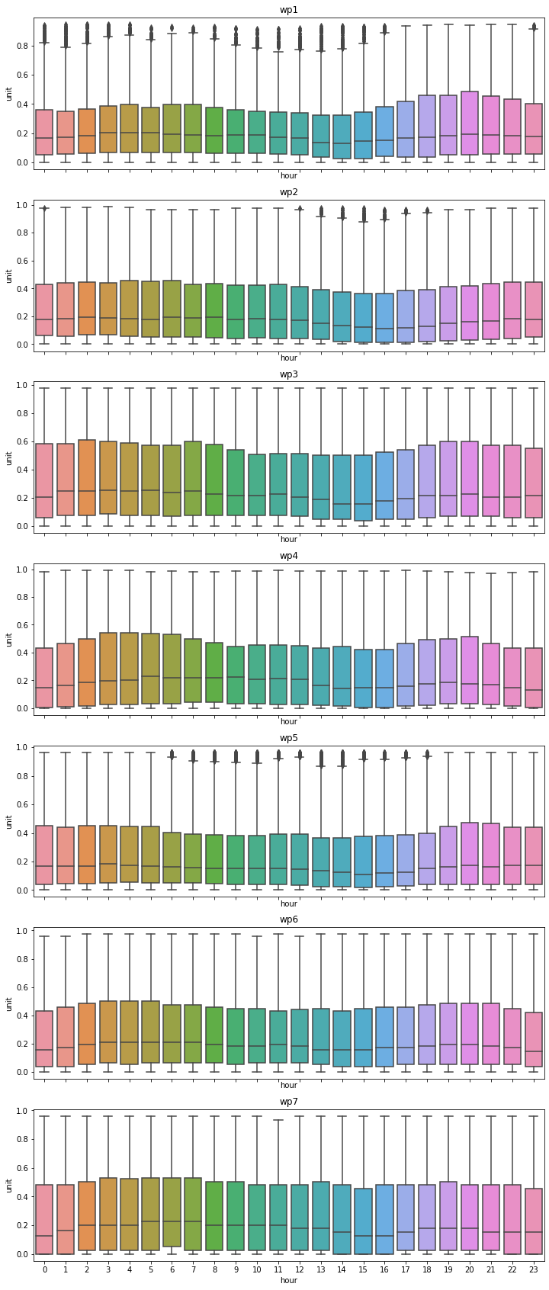

Slide 3
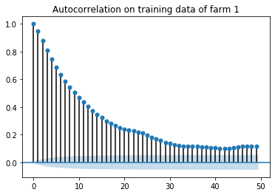
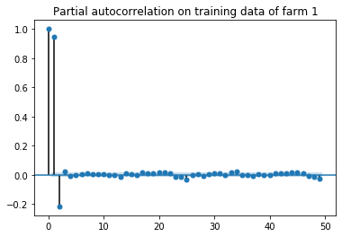
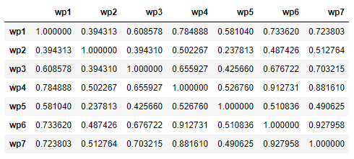
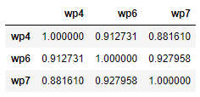

Slide 4
Dataset
Wind Power (wp)
NWP (ws, wd)
Seasonal Feature
Layer 1: Linear Model
Unsupervised Feature
Layer 2: Non-linear Models
f0
f1
f6
f7
f10
f11
f12
f13
f15
WPP
WPP
WPP
WPP
WPP
WPP
WPP
WPP
WPP
Layer 3: Linear Model (Stacked Regression)
Post-processing
Submitted WPP

Slide 5








Dataset
Wind Power (wp)
NWP (ws, wd)
Seasonal Feature
Layer 1: Linear Model
Unsupervised Feature
Layer 2: Non-linear Models
…
Model $1$
Model $2$
Model $3$
Model $n$
WPP $1$
WPP $2$
WPP $3$
WPP $n$
Layer 3: Linear Model (Stacked Regression)
Post-processing
Submitted WPP

Slide 6
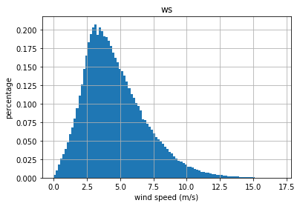
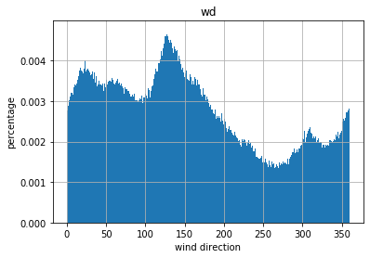

Slide 7
